Slide 1
Title Proposal

Slide 2
What is a Title Proposal?
The title summarizes the main idea or ideas of your study. A good title contains the fewest possible words needed to adequately describe the content and/or purpose of your research paper.

Slide 3
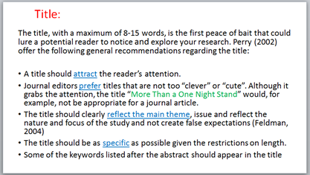
Examples of Thesis Titles

Slide 4
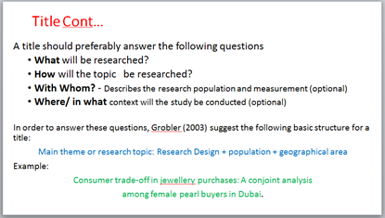

Slide 5
Project Context
Minimum of two paragraphs. 6 sentences per paragraph. The discussion of Project Context should start from General topic (1st Paragraph) down to Specific Topic (2nd Paragraph). Project Context contains the brief description of proposed thesis titles.

Slide 6
Example
“The health services department, although exceptional, still has some room for improvement. It is a standard process in the University for Students to undergo physical examination on the date set by the department. The university conducts these examinations in order to ensure the physical wellness of the students. If ever the student fails to do so, the students might get tagged in the system which will result in the student’s Pinnacle to show limited information.
The researcher thought of developing a web application to be utilized by the students, administrative personnel and staff under the Health Services department to aid in administering their services more effectively.”
Reference: “MCU HealthServ App Using Ricart-Agrawala Algorithm”

Slide 7
Conceptual Framework
A conceptual framework is an analytical tool with several variations and contexts. It is used to makeconceptual distinctions and organize ideas. Strongconceptual frameworks capture something real and do this in a way that is easy to remember and apply.

Slide 8
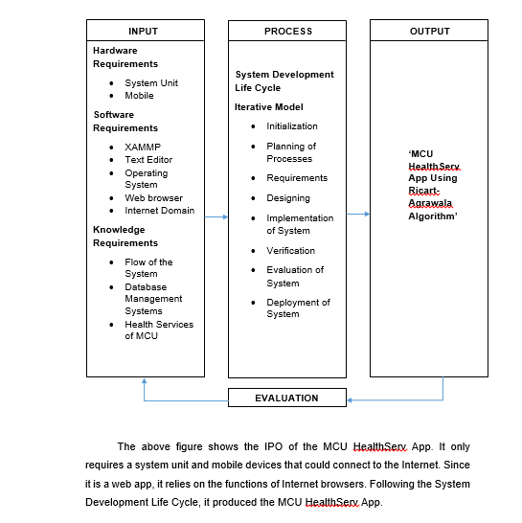
Example:

Slide 9
Scope and Limitation
*The scope and limitation of the study contains at least 2 Paragraphs 6 sentences per paragraph. Discuss the scope or the function of proposed system in the first paragraph. The second paragraph is the limitation with 6 sentences.

Slide 10
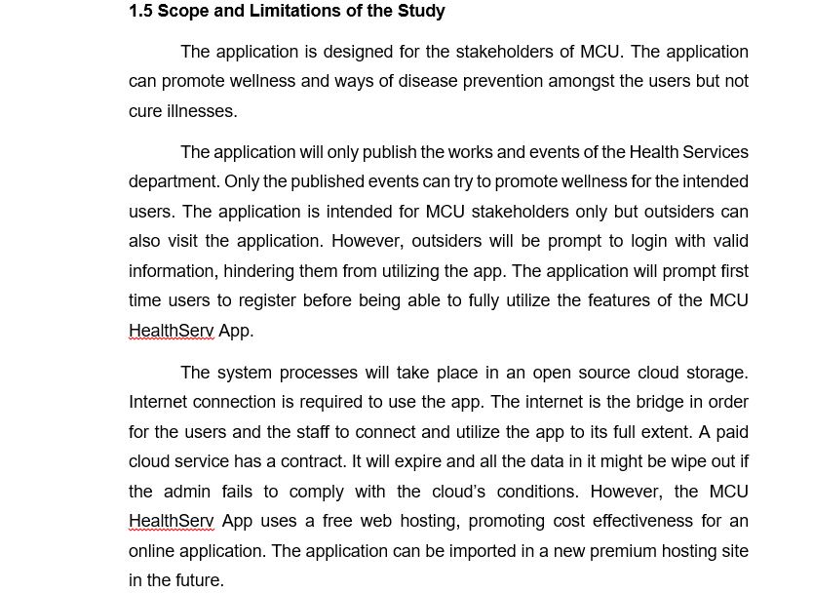
Example
Reference: “MCU HealthServ App Using Ricart-Agrawala Algorithm”

